Slide 1


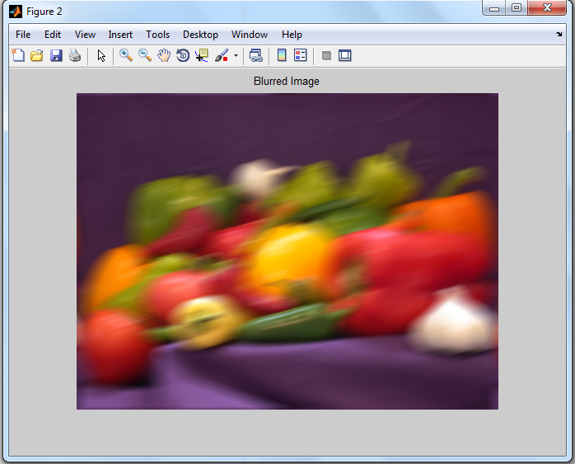
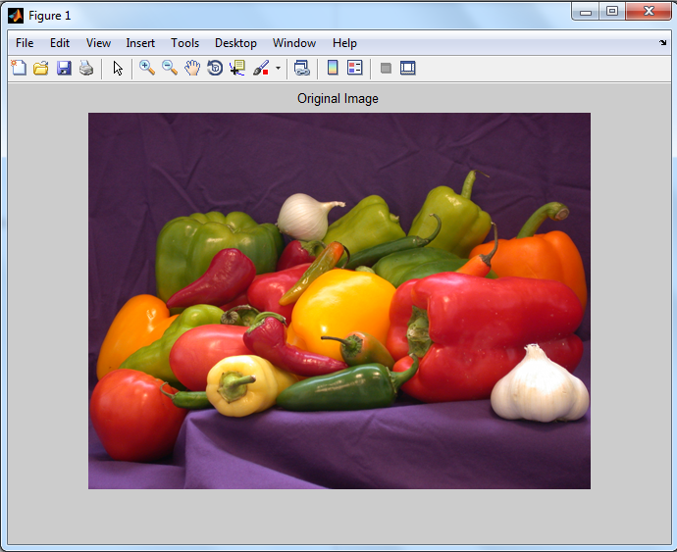
Biomedical Laboratory – 4th Year
Part : one
Image Processing Using MATLAB
Lab. No.“2”
Deblurring Images Using the Wiener Filter

Slide 2
Introduction
Wiener Filter deconvolution can be useful when the frequency characteristics of the image and additive noise level are known, to at least some degree.
Introduction
Application:
Simulate a blurred image that you might get from camera motion and deblurring that blurred image using a Wiener Filter deconvolution to recover the original image.
Procedural steps:
Step 1: Read and Display the Image
Step 2: Simulate a Motion Blur
Step 3: Restore the Blurred Image
Notes:
Analytical model is derived based on governing physical laws for the system such as Newton's law, Ohms law, etc.
Experimental model is derived based on experimental empirical results and samples for the system.
Numerical values of the model parameters are often approximated from experimental data by curve fitting.
Discrimination learning models are drived

Slide 3
Step 1: Read and Display The Image
1.1 Key Commands:
I = imread('filename.fmt') :reads a grayscale or color image specified by filename and format fmt and stores it into array variable I. If the file is not in the current folder, or in a folder on the MATLAB path, specify the full pathname as:
I = imread(‘D:\pictures\asd.jpg’)
Read The Image
figure :creates a new figure object using default property values, and automatically becomes the current figure until a new figure is either created or called.
imshow(I) :displays the stored image of the variable array I.
title('string') :adds the title specified by ‘string’ at the top and in the center of the current axes or figure.
Notes:
Analytical model is derived based on governing physical laws for the system such as Newton's law, Ohms law, etc.
Experimental model is derived based on experimental empirical results and samples for the system.
Numerical values of the model parameters are often approximated from experimental data by curve fitting.
Discrimination learning models are drived

Slide 4
Step 1: Read and Display The Image
1.2 Step application:
Read in and display the ‘peppers.png' RGB image .
I = imread(‘peppers.png');
figure, imshow(I), title('original image');
Read The Image
Notes:
Analytical model is derived based on governing physical laws for the system such as Newton's law, Ohms law, etc.
Experimental model is derived based on experimental empirical results and samples for the system.
Numerical values of the model parameters are often approximated from experimental data by curve fitting.
Discrimination learning models are drived

Slide 5
Step 2: Simulate a Motion Blur
2.1 Preface:
Simulate a blurred image that you might get from camera motion. Create a point-spread function, PSF, corresponding to the linear motion across 31 pixels (LEN=31), at an angle of 11 degrees (THETA=11). Simulate the blur using imfilter.
Simulate a Motion Blur
2.2 Key Commands:
PSF = fspecial('motion', lEN, THETA) :Creates a point-spread function, PSF, corresponding to the linear motion of a camera by LEN pixels, with an angle of THETA degrees in a counterclockwise direction.
blurred = imfilter(I, PSF, 'circular') :performs image filtering using the predefined point-spread function, PSF according to the specified options as 'circular', 'symmetric', 'replicate',…etc
Notes:
Analytical model is derived based on governing physical laws for the system such as Newton's law, Ohms law, etc.
Experimental model is derived based on experimental empirical results and samples for the system.
Numerical values of the model parameters are often approximated from experimental data by curve fitting.
Discrimination learning models are drived

Slide 6
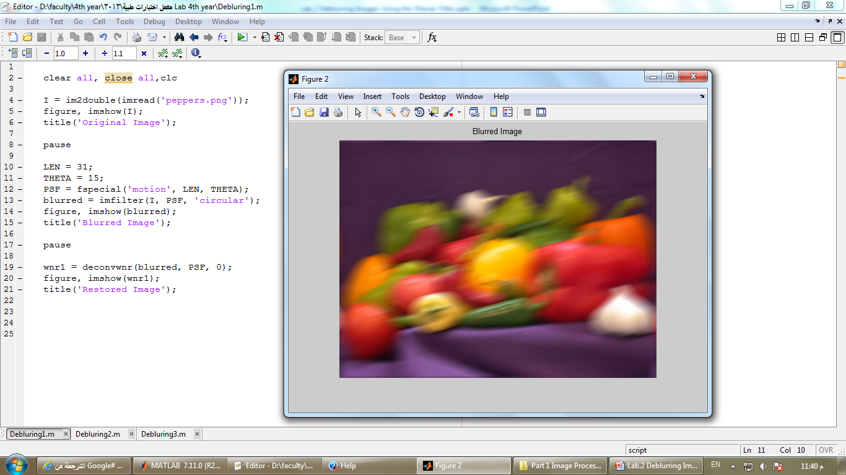
Step 2: Simulate a Motion Blur
2.3 Step application:
LEN = 31;
THETA = 15;
PSF = fspecial('motion', LEN, THETA);
blurred = imfilter(I, PSF, 'circular');
figure,imshow(blurred),title('Blurred Image');
Simulate a Motion Blur
Notes:
Analytical model is derived based on governing physical laws for the system such as Newton's law, Ohms law, etc.
Experimental model is derived based on experimental empirical results and samples for the system.
Numerical values of the model parameters are often approximated from experimental data by curve fitting.
Discrimination learning models are drived

Slide 7
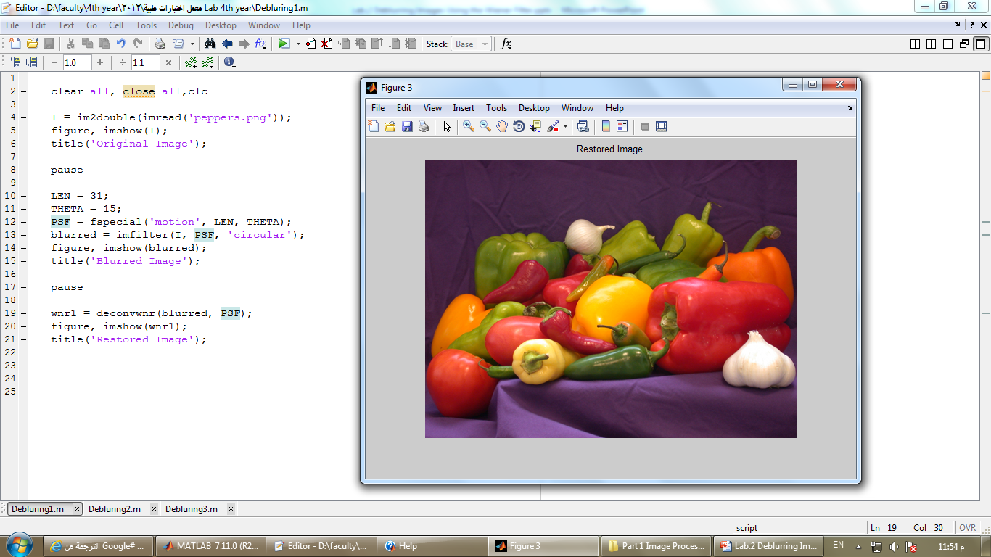
Step 3: Restore the Blurred Image
3.1 Step application:
wnr1 = deconvwnr(blurred, PSF);
figure,imshow(wnr1),title('Restored Image');
Restore the Blurred Image
Notes:
Analytical model is derived based on governing physical laws for the system such as Newton's law, Ohms law, etc.
Experimental model is derived based on experimental empirical results and samples for the system.
Numerical values of the model parameters are often approximated from experimental data by curve fitting.
Discrimination learning models are drived

Slide 8


Questions and Discussion
Questions and Discussion
Notes:
Analytical model is derived based on governing physical laws for the system such as Newton's law, Ohms law, etc.
Experimental model is derived based on experimental empirical results and samples for the system.
Numerical values of the model parameters are often approximated from experimental data by curve fitting.
Discrimination learning models are drived

